Slide 1
IP Services
Chapter 17 (Todd Lammle)
Chapter 2 (CCNA3 Scaling Networks)

Slide 2
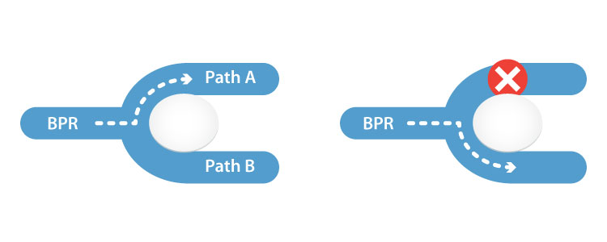
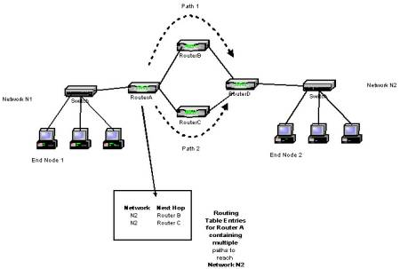
Multiple Paths To Serve as Backup without any downtime in the network
Network Redundancy

Slide 3
First Hop Redundancy Protocol FHRP

Slide 4
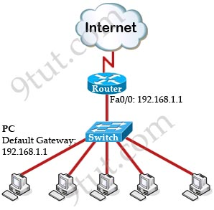
FHRP Concept
To access Internet all PCs require Default Gateway
Single Point of Failure
Solution : Default Gateway Redundancy can solve all these problems!

Slide 5
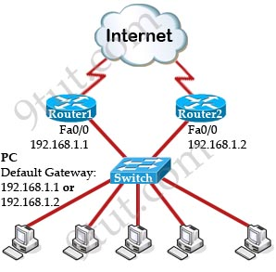
FHRP Concept
Problem : Only one default gateway on each host.
If Router1 is down, need to change the default gateway (to 192.168.1.2).
Also, when Router1 comes back, ned to manually change back to Router1.
And no one can access to the Internet in the time of changing the default gateway.
FHRP can solve all these problems!

Slide 6
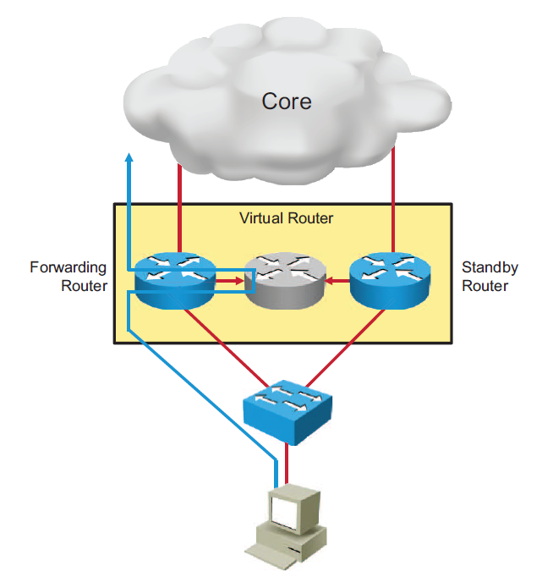
FHRP Concept
2 routers Router1 and Router2 will be seen as only one router.
It will use a virtual MAC and IP address for the two routers to represent with hosts as a single default gateway.
One router is designated as active router while the other router is designated as standby router.
Only the active router forwards packets.
Standby router is backup when active router fails by monitoring periodic hellos sent by the active router

Slide 7
FHRP
The redundancy protocol provides the mechanism for determining which router should take the active role in forwarding traffic
And determining when that role must be taken over by a standby router.
The transition from one forwarding router to another is transparent to the end devices.
Three redundancy protocols:
Hot Standby Router Protocol (HSRP)
Virtual Router Redundancy Protocol (VRRP)
Gateway Load Balancing Protocol (GLBP)

Slide 8
Hot Standby Redundancy Protocol - HSRP

Slide 9
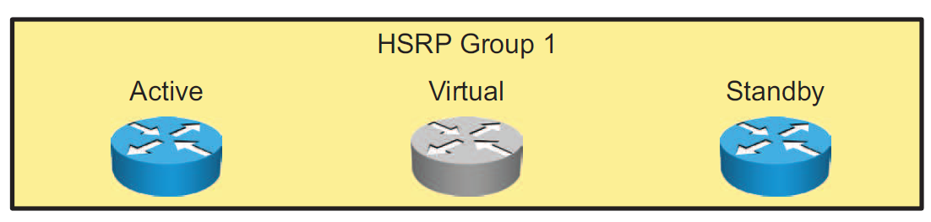
Hot Standby Redundancy Protocol - HSRP
HSRP defines a group of routers -- one active and one standby.
Virtual IP and MAC addresses are shared between the two routers.
To verify HSRP state, use the show standby command.
HSRP is Cisco proprietary, and VRRP is a standard protocol.

Slide 10
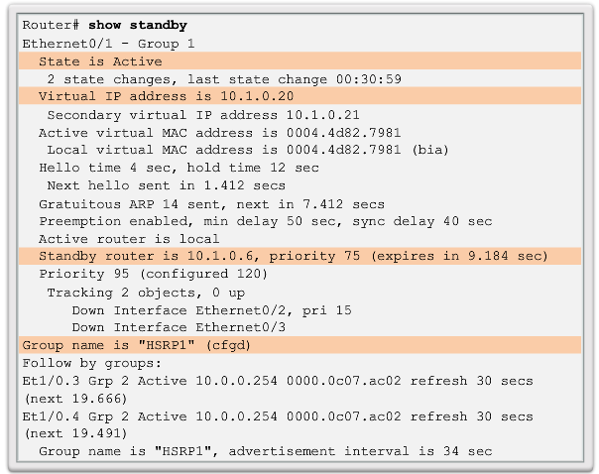
Hot Standby Redundancy Protocol - HSRP

Slide 11
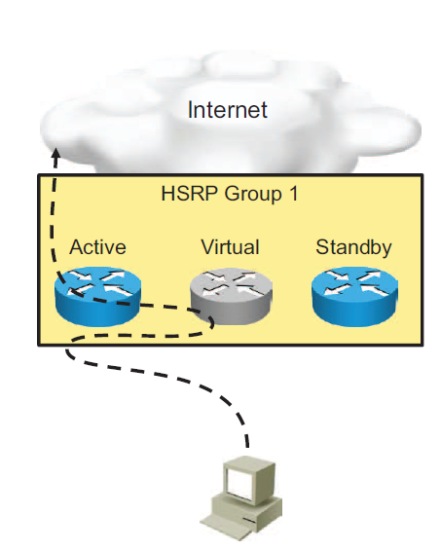
HSRP (Cont.)
Active router:
Responds to default gateway ARP requests with the virtual router MAC address
Assumes active forwarding of packets for the virtual router
Sends hello messages
Knows the virtual router IP address
Standby Router
Listens for periodic hello messages
Assumes active forwarding of packets if it does not hear from active router

Slide 12
HSRP (Cont.)
Virtual router:
Not a physical entity
Defines the role held by the one of the physical routers
Nothing more than a separate IP address and MAC address where packets are sent
Other Routers
Members of the group but don’t take the primary roles.
Monitor Hello messages to ensure Active and Standby Routers exist

Slide 13
Virtual MAC Address
The IP address and corresponding MAC address of the virtual router is maintained in the ARP table of each router in an HSRP standby group.
First 24 bits Vendor ID
The next 16 bits (07.ac) are well known HSRP ID. (Assigned by Cisco)
The last 8 bits only variable bits representing the group number.
The MAC address of the HSRP virtual router is 0000.0c07.acxx, where xx is the HSRP group identifier.
Here are a few examples:
Group 1 = 0000.0c07.ac01
Group 16 = 0000.0c07.ac10
Group 47 = 0000.0c07.ac2f

Slide 14
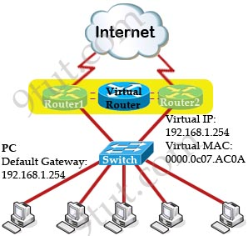
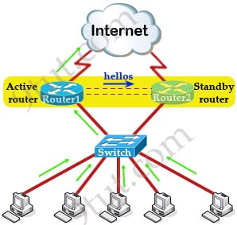
HSRP (Cont.)
All routers in a HSRP group send multicast hello packets.
Hello msgs contain information for the election of active and standby router positions.
By default, the hello timer is set to 3 seconds and the dead timer is set to 10 seconds.

Slide 15
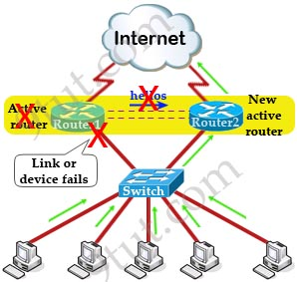
HSRP (Cont.)
The standby device becomes active when a hello packet has not been received for 10 seconds.
The new forwarding router uses the same (virtual) IP and MAC addresses.
So the hosts see no disruption in communication.

Slide 16
HSRP States
A router in an HSRP standby group can be in one of the following states: initial, listen, speak, standby, or active.
Initial: This is the starting state and indicates that HSRP is not running.
Listen: In the listen state, the router knows the IP address of the virtual router, but is neither the active router nor the standby router.
Speak: In the speak state, the router sends periodic hello messages and is actively participating in the election of the active router or standby router.
The router will remain in the speak state unless it becomes an active or standby router.

Slide 17
HSRP States
Standby: In the standby state, because the router is a candidate to become the next active router and will listen for hellos from the active router.
There is only one standby router for the HSRP group.
Active: In the active state, the router is currently forwarding packets that are sent to the virtual MAC address of the group.

Slide 18
Configuring HSRP
Routers A and B are configured with priorities of 110 and 90, respectively. The configuration of Router A is displayed. A similar configuration is required on Router B.
The preempt keyword ensures that Router A will be the HSRP active router as long its interface is active and sending hellos.
HSRP
Group 1
Router A
Priority
110
Router B
Priority
90
RouterA(config)# interface GigabitEthernet0/0
RouterA(config-if)# ip address 10.1.10.2 255.255.255.0
RouterA(config-if)# standby 1 ip 10.1.10.1
RouterA(config-if)# standby 1 priority 110
RouterA(config-if)# standby 1 preempt

Slide 19
HSRP Preempt
In the event of an active router failure, a standby router will assume the role of active router.
By default, the new active router will retain its role as active when the former active router comes back online, even if it has a higher priority than the current active router.
In order for the former active router to regain its role as active we must configure the ‘preempt’ option.
RouterA(config-if)# standby 1 preempt

Slide 20
HSRP Verification
Use the show standby command to verify the HSRP state.
RouterA# show standby
GigabitEthernet0/0 - Group 1 (version 2)
State is Active
2 state changes, last state change 00:00:18
Virtual IP address is 10.1.10.1
Active virtual MAC address is 0000.0C9F.F001
Local virtual MAC address is 0000.0C9F.F001 (v2 default)
Hello time 3 sec, hold time 10 sec
Next hello sent in 2.278 secs
Preemption enabled
Active router is local
Standby router is 10.1.10.3, priority 90 (expires in 9 sec)
Priority 110 (configured 110)
Group name is hsrp-Gig0/0-1 (default)

Slide 21
HSRP Verification (Cont.)
The show standby brief command displays a summary of the HSRP configurations.
RouterA# show standby brief
P indicates configured to preempt.
|
Interface Grp Pri P State Active Standby Virtual IP
Gig0/0 1 110 P Active local 10.1.10.3 10.1.10.1

Slide 22
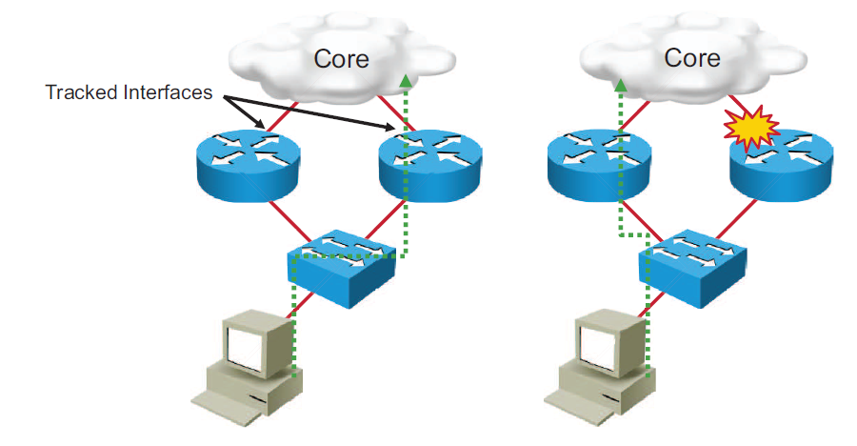
HSRP Interface Tracking
Notes:
The HSRP group tracks the uplink interfaces. If the uplink on the right switch fails, the router automatically decrements the priority on that interface and sends hello messages with the decremented priority.
Assume that, in the example in the figure, the router on the right is configured with a higher priority, and therefore is handling the traffic toward the core. As soon as the interface through the router on the right fails, the host will be unable to reach the core network. HSRP will make the router on the left the active router.

Slide 23
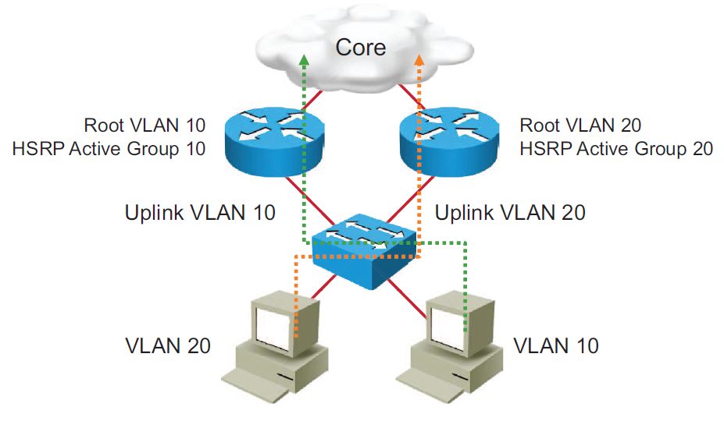
HSRP Load Balancing

Slide 24
Virtual Router Redundancy Protocol VRRP

Slide 25
Virtual Router Redundancy Protocol (VRRP)
Like HSRP, Virtual Router Redundancy Protocol (VRRP) allows a group of routers to form a single virtual router.
VRRP is an IEEE standard for router redundancy, HSRP is a Cisco proprietary
The virtual router, representing a group of routers, is known as a VRRP group.
The active router is referred to as the master virtual router.
The master virtual router may have the same IP address of the virtual router group.
Multiple routers can function as backup routers.

Slide 26
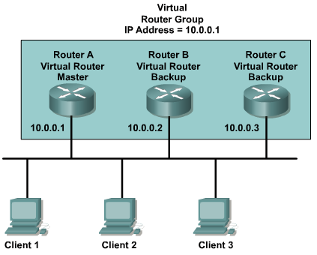
VRRP Example

Slide 27
Gateway Load Balancing Protocol GLBP

Slide 28
Gateway Load Balancing Protocol (GLBP)
The main disadvantage of HSRP and VRRP is that only one gateway is elected to be the active gateway.
Used to forward traffic whilst the rest are unused until the active one fails.
Gateway Load Balancing Protocol (GLBP) is a Cisco proprietary protocol.
Performs the similar function to HSRP and VRRP but it supports load balancing among members in a GLBP group.

Slide 29
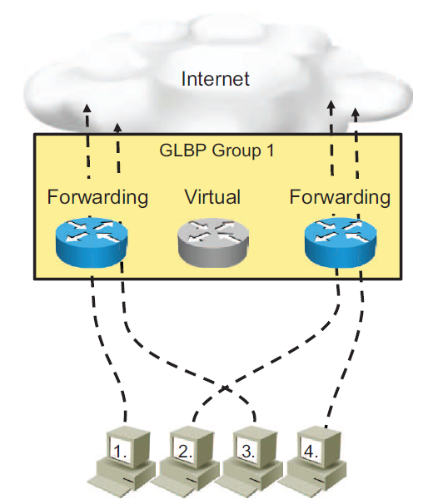
Gateway Load Balancing Protocol
Allows full use of resources on all devices without the administrative burden of creating multiple groups
Provides a single virtual IP address and multiple virtual MAC addresses
Routes traffic to single gateway distributed across routers
Provides automatic rerouting in the event of any failure

Slide 30
GLBP Operation
The members of a GLBP group elect one gateway to be the Active Virtual Gateway (AVG) for that group.
The AVG is the router with the highest priority or IP addr.
Other members of that group provide backup for the AVG.
The AVG assigns a virtual MAC address to each member of the GLBP group, called Active Virtual Forwarder (AVF). (Max 4 AVFs)
The virtual MAC address in GLBP is 0007.b400.xxyy where xx is the GLBP group number and yy is the different number of each gateway (01, 02, 03…).
If there are more than 4 gateways in a GLBP group then the rest will become Standby Virtual Forwarder (SVF) which will take the place of a AVF in case of failure.
The AVG answers all ARP requests sent from clients and responds with one of the virtual MAC addresses of a member of the GLBP group.
Each router in the GLBP group is called an Active Virtual Forwarder (AVF).

Slide 31
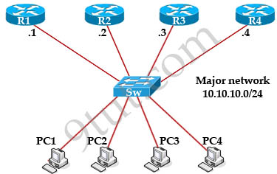
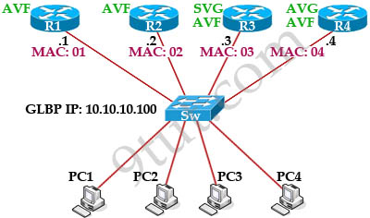
GLBP Example
Same priority
Still one virtual IP address which is assigned by the administrator via the “glbp ip …” command (for example glbp 1 ip 10.10.10.100).

Slide 32
GLBP Example
After the election ends, R4 is both the AVG and AVF; R3 is SVG and AVF; R2 & R1 are pure AVFs.
R4 assigned the MAC addresses of 0007.b4000101, 0007.b4000102, 0007.b4000103, 0007.b4000104 to R1, R2, R3, R4 respectively.
The default gateway of PC1, PC2 and PC3 were set to 10.10.10.100 so if they want to send traffic outside they have to send ARP Request first to their default gateway.
R4 will respond with different MAC addresses to the different PCs.

Slide 33
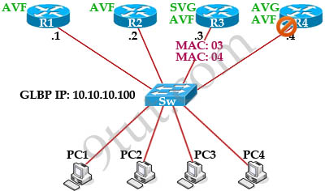
GLBP Example
Suddenly R4 (AVG) is down.
R3 was chosen as SVG because of its second highest priority so when R4 is down, R3 becomes the new AVG and is responsible for forwarding traffic sent to the virtual MAC address of R4.
Communication between R4 continues without disruption or change at the host side.
How can the switch forward the frames to the new SVG on another port?
SVG will send a gratuitous ARP reply to flush the CAM tables of the switches and the ARP cache of the hosts.

Slide 34
GLBP Example
Each AVF listens to others, if one AVF can no more forward traffic, all listening AVFs will compete to take the responsibility of the failed AVF (AVF with higher weighting wins).
To detect a gateway failure, GLBP members communicate between each other through hello messages sent every 3 seconds to the multicast address 224.0.0.102, User Datagram Protocol (UDP) port 3222.
GLBP supports up to 1024 virtual routers (GLBP groups) per physical interface of a router.

Slide 35
GLBP Modes
GLBP supports different modes of load balancing:
Weighted load-balancing
Uses the configured weight value
Each GLBP router in the group will advertise its weighting and assignment; the AVG will act based on that value
Host-dependent
Same host always uses the same virtual MAC
Round-robin
Each router MAC is used sequentially to respond to ARP requests
Each ARP reply contains the virtual MAC address of the next router in the group

Slide 36
VRRP and GLBP Configuration
VRRP Implementation:
Switch(config)#interface vlan10
Switch(config-if)#ip address 10.1.10.5 255.255.255.0
Switch(config-if)#vrrp 10 ip 10.1.10.1
GLBP Implementation:
Router(config)#interface fa0/1
Router(config-if)#ip address 10.1.10.5 255.255.255.0
Router(config-if)#glbp 10 ip 10.1.10.1
Router(config-if)#glbp 10 priority 150
Router(config-if)#glbp 10 preempt
Router(config-if)#glbp 10 timers msec 250 msec 750

Slide 37
Gateway Load Balancing Protocol (Cont.)
R1#show glbp
FastEthernet0/0 - Group 1
State is Active
2 state changes, last state change 00:04:12
Virtual IP address is 192.168.2.100
<output omitted>
Active is local
Standby is 192.168.2.2, priority 100 (expires in 7.644 sec)
Priority 100 (default)
Weighting 100 (default 100), thresholds: lower 1, upper 100
Load balancing: round-robin
Group members:
c000.0ce0.0000 (192.168.2.1) local
c001.0ce0.0000 (192.168.2.2)
<output omitted>
The show glbp command in this example displays information about the status of GLBP group 1.
Notes:
To display GLBP information, use the show glbp command in privileged EXEC mode.
The example output shows that the virtual router IP address is 192.168.2.100 and that one router is in the Active state and the other router is in the Listen state. "Active" indicates that this router is responsible for responding to ARP requests for the virtual IP address. "Listen" indicates that the router is receiving hello packets and is ready to be activated if the currently active router fails.

Slide 38
Gateway Load Balancing Protocol (Cont.)
R1#show glbp
<output omitted>
There are 2 forwarders (1 active)
Forwarder 1
State is Active
1 state change, last state change 00:04:02
MAC address is 0007.b400.0101 (default)
Owner ID is c000.0ce0.0000
Redirection enabled
Preemption enabled, min delay 30 sec
Active is local, weighting 100
Forwarder 2
State is Listen
The show glbp command in this example displays information about the status of GLBP group 1.

Slide 39
Syslog

Slide 40
Syslog
Something that will alert you when something goes wrong or down in your network
Syslog is an excellent tool for system monitoring
Syslog permits various Cisco devices (and some other non-Cisco devices) to send their system messages across the network to syslog servers
There are many different Syslog server software packages for Windows and UNIX

Slide 41
Popular destinations for syslog messages
The logging buffer (RAM inside the router or switch)
The console line
The terminal lines
A syslog server

Slide 42
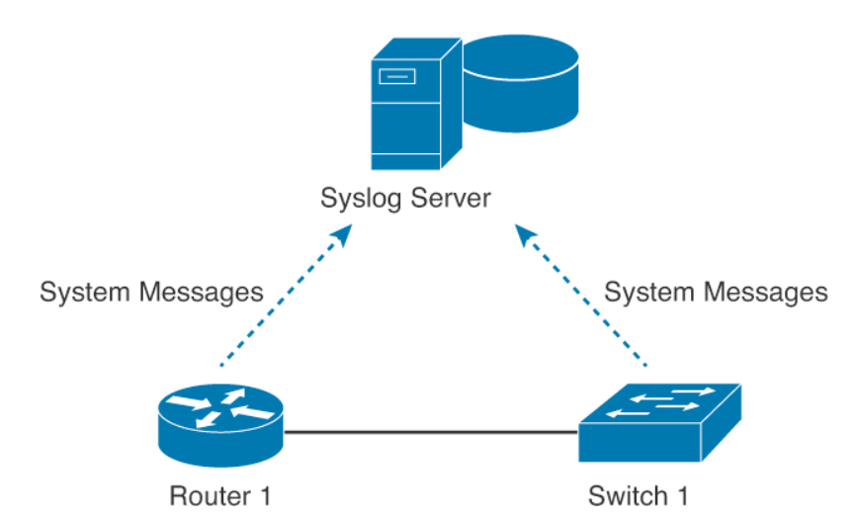
Syslogging in the Network

Slide 43
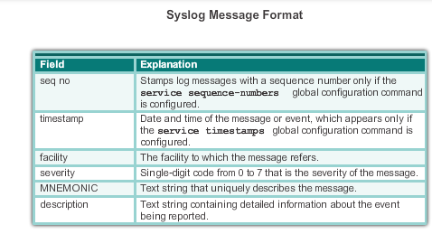
System Message Format

Slide 44

System Message Format
A timestamp: *Dec 18 17:10:15.079
The facility on the router that generated the message: %LINEPROTO
The severity level: 5
A mnemonic for the message: UPDOWN
The description of the message: Line protocol on Interface FastEthernet0/0, changed state to down

Slide 45
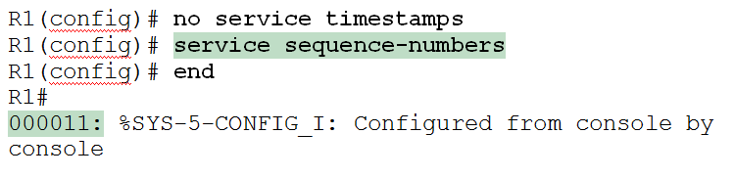
Modifying System Messages

Slide 46
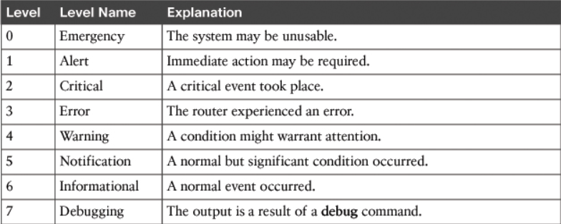
System Message Severity Levels

Slide 47
Configuring and Verifying Syslog
R1(config)#logging 192.168.1.101
R1(config)#logging trap 4
By default, Cisco routers and switches send log messages for all severity levels to the console. On some IOS versions, the device also buffers those log messages by default
R1(config)# logging console
R1(config)# logging buffered
R1# show logging

Slide 48
Simple Network Management Protocol SNMP

Slide 49
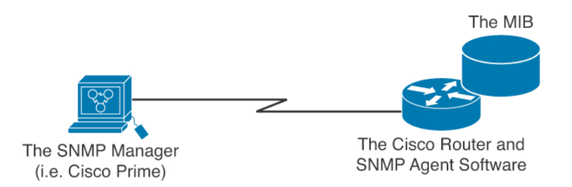
SNMP
SNMP is an application layer protocol that provides a message format for communication between what are termed managers and agents
Components include
SNMP manager
SNMP agent
Management Information Base (MIB)

Slide 50
SNMP
SNMP Manager – Also called Network Management System (NMS)
a software runs on the device of the network administrator (in most case, a computer) to monitor the network.
SNMP Agent
a software runs on network devices that we want to monitor (router, switch, server…)
Management Information Base (MIB)
Collection of managed objects.
Makes sure that the data exchange between the manager and the agent remains structured.
In other words, MIB contains a set of questions that the SNMP Manager can ask the Agent (and the Agent can understand them).

Slide 51
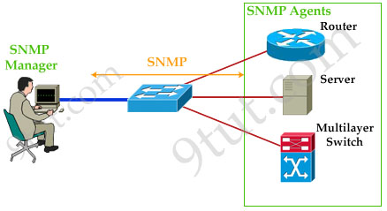
SNMP

Slide 52
SNMP Messages
Get
Set
Trap – unreliable
Inform (From SNMPv2) – reliable using ACK

Slide 53
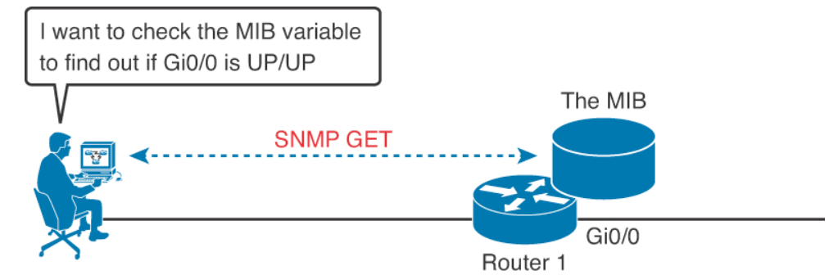
SNMP in Use for Monitoring the Network

Slide 54
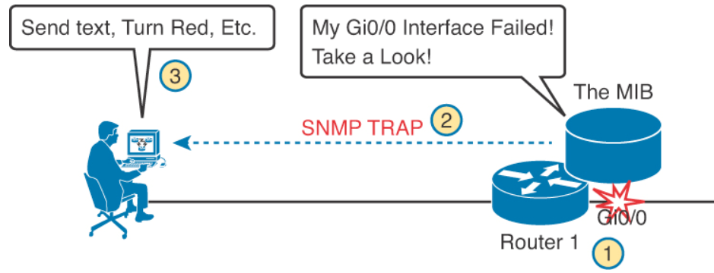
SNMP in Use for Monitoring the Network

Slide 55
The Management Information Base (MIB)
MIB defines each variable as an object ID (OID)
Organizes the into a hierarchy of OIDs, usually shown as a tree
MIB for any device includes some branches of the tree with variables common to many networking devices and branches with variables specific to that device.
Networking equipment vendors like Cisco can define their own private branches of the tree

Slide 56
SNMP Versions
Three main versions:
SNMP version 1
original version and is very legacy
So not used.
SNMP version 2c
SNMP version 3

Slide 57
SNMPv2c
Offered some enhancements over SNMPv1.
For example, the introduction of INFORM and GETBULK messages.
Both SNMPv1 and v2c did not focus much on security .
Both provide security based on community string only.
Community string is really just a clear text password (without encryption). Any data sent in clear text over a network is vulnerable to packet sniffing and interception.

Slide 58
Configuring SNMPv2
There are two types of community strings in SNMP Version 2c:
Read-only (RO): Provides access to the MIB variables, but does not allow these variables to changed, only read. Because security is so weak in Version 2c, many organizations only use SNMP in this read-only mode.
Read-write (RW): Provides read and write access to all objects in the MIB.

Slide 59
SNMPv3
Provides significant enhancements to address the security weaknesses existing in the earlier versions.
The concept of community string does not exist in this version.

Slide 60
SNMPv3
Message integrity: This helps ensure that a packet has not been tampered with in transit
Authentication: This helps ensure that the packet came from a known and trusted source
Encryption: This helps to ensure that information cannot be read if the data is captured in transit

Slide 61
Configuring SNMP
Four Steps
Enable SNMP read-write access to the router.
Configure SNMP contact information.
Configure SNMP location.
Configure an ACL to restrict SNMP access to the NMS hosts.

Slide 62
Configuring SNMP Version 2c
Router(config)#snmp-server community Todd rw
Router(config)#snmp-server contact Todd Lammle
Router(config)#snmp-server location Boulder
Router(config)#ip access-list standard Protect_NMS_Station
Router(config-std-nacl)#permit host 192.168.10.254

Slide 63
NETFLOW

Slide 64
Netflow
SNMP and other network management protocols allow to monitor the network.
To check things like cpu load, memory usage, interface status and even the load of an interface.
But unable to track flows in the network
A flow is a stream of packets having the same characteristics like
Source/destination port
Source/destination address
protocol type etc

Slide 65
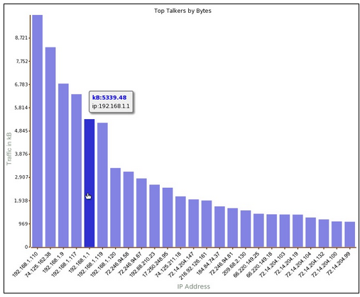
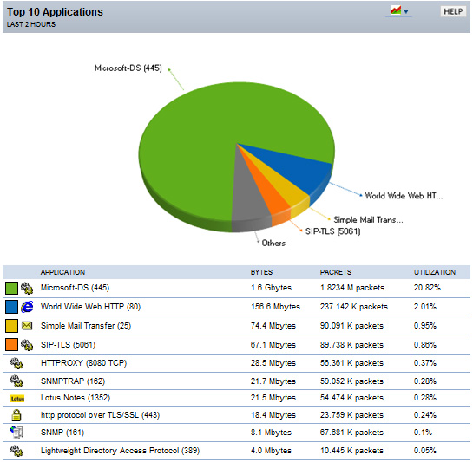
Netflow
To solve problems like bottlenecks, identify what applications are used, how much bandwidth they use etc.
For each of the flows, NetFlow will track the number of packets sent, bytes sent, packet sizes and more.
Routers can be configured to keep track of all flows and then export them to a central server where the traffic can be analyzed.
Notes:
Based on the usage of NetFlow analyzers, you will be able to identify the following:
- The major users of the network
- The websites that are routinely visited and what is downloaded
- Who is generating the most traffic
- If you have enough bandwidth to support mission-critical activity
- Who is using excessive bandwidth

Slide 66
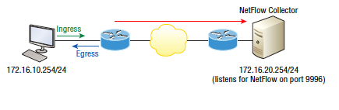
NetFlow Overview (Cont.)
NetFlow components:
- NetFlow-enabled network devices
- NetFlow collector
NetFlow devices generate NetFlow records that are exported and then collected by a NetFlow collector.
NetFlow-Enabled Router
NetFlow Collector
Notes:
NetFlow components include the following:
- Network devices that are configured for NetFlow
- NetFlow Collector, which receives NetFlow information from network devices
Network devices collect IP traffic statistics on interfaces where NetFlow is configured. Network devices then export these statistics as NetFlow records to a central server that runs NetFlow Collector software. The Collector also performs traffic analysis.

Slide 67

NetFlow Overview (Cont.)
Cisco defines a flow as a unidirectional sequence of packets with seven common values:
- Source IP address
- Destination IP address
- Source port number
- Destination port number
- Layer 3 protocol type
- ToS
- Input logical interface
Notes:
A NetFlow network flow is defined as a unidirectional stream of packets between a given source and destination. The source and destination are each defined by a network layer IP address and transport layer source and destination port numbers.
A flow is defined by the combination of seven key fields, which define a unique flow. If a packet has one key field that is different from another packet, it is considered to belong to another flow. Flows are stored in the NetFlow cache.
Note ToS is a field in the IP header. It is used as a quality of service (QoS) mechanism to mark IP packets with different priorities in
order to receive different treatment in terms of throughput, reliability, and latency.

Slide 68
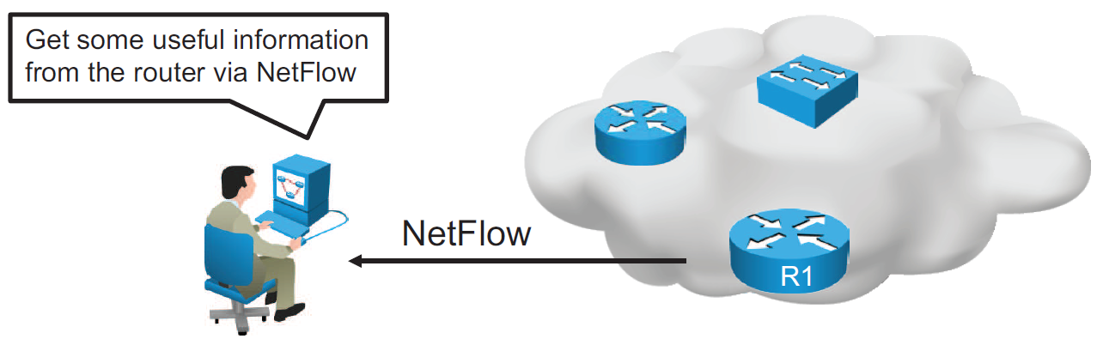
NetFlow Configuration
Configure NetFlow data capture
Configure NetFlow data export
Configure NetFlow data export version
Verify NetFlow, its operation, and statistics
Notes:
To implement NetFlow on a router, you must do the following:
Configure NetFlow data capture: NetFlow can capture data from ingress (incoming) and egress (outgoing) packets.
Configure NetFlow data export: You need to specify the IP address or hostname of the NetFlow collector and the UDP port that the NetFlow collector listens to. Optionally, you can specify an interface to use for the source IP address of the packet sent to the collector.
Configure NetFlow data export version: You can specify the version of NetFlow data export format.
Verify NetFlow, its operation, and statistics: After you have configured NetFlow, you can analyze the exported data on a workstation running an application such as NetFlow Collection Engine or using several show commands on the router itself.
Note Be aware that NetFlow consumes additional memory. If you have memory constraints, you can preset the size of the NetFlow cache so that it contains a smaller number of entries. The default cache size depends on the platform.

Slide 69
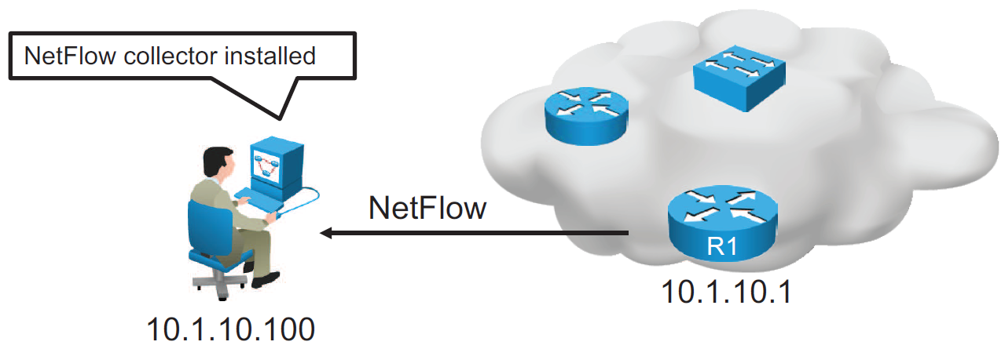
NetFlow Configuration (Cont.)
R1(config)# interface GigabitEthernet0/0
R1(config-if)# ip flow ingress
R1(config-if)# ip flow egress
R1(config-if)# exit
R1(config)# ip flow-export destination 10.1.10.100 9996
R1(config)# ip flow-export version 9
Configuration of NetFlow on router R1
Notes:
Configuration of NetFlow is based on the following commands:
ip flow {ingress | egress}
Enables NetFlow on the interface. Captures traffic that is being received or being transmitted by the interface.
ip flow-export destination ip-address udp-port
IP address of the workstation to which you want to send the NetFlow information and the number of the UDP port on which the workstation is listening for this input. UDP port 9996 is commonly used for NetFlow.
ip flow-export version version
Specifies the version format that the export packet uses.
The figure shows configurations for NetFlow data capture and data export to NetFlow collector with IP address 10.1.10.100, where you can analyze the exported data.
Traffic that is being either received or transmitted by the GigabitEthernet 0/0 interface is captured using the ip flow command. Captured NetFlow information is then sent to the collector with IP address 10.1.10.100 on UDP port 9996. The ip flow-export version command specifies that the export packet uses the version 9 format.
Note NetFlow exports data in UDP in one of five formats (1, 5, 7, 8, and 9). Version 9 is the most versatile data export format but is not backward compatible with version 8 or version 5.

Slide 70
NetFlow Configuration (Cont.)
R1# show ip flow interface
GigabitEthernet0/0
ip flow ingress
ip flow egress
Displays if NetFlow is enabled on an interface
R1# show ip flow export
Flow export v9 is enabled for main cache
Export source and destination details :
VRF ID : Default
Destination(1) 10.1.10.100 (9996)
Version 9 flow records
43 flows exported in 15 udp datagrams
Displays the status and the statistics for NetFlow data export
Notes:
You can use the show ip flow interface command to verify if NetFlow is enabled on an interface. In the example, NetFlow is enabled in the ingress and egress directions on the GigabitEthernet0/0 interface.
Use the show ip flow export command to verify the status and statistics for NetFlow accounting data export. In the example, the configured destination for NetFlow export is 10.1.10.100 using UDP port 9996. The version of the configured flow export is 9.

Slide 71
NetFlow Configuration (Cont.)
R1# show ip cache flow
<output omitted>
IP Flow Switching Cache, 278544 bytes
2 active, 4094 inactive, 31 added
6374 ager polls, 0 flow alloc failures
Active flows timeout in 30 minutes
Inactive flows timeout in 15 seconds
IP Sub Flow Cache, 34056 bytes
2 active, 1022 inactive, 31 added, 31 added to flow
0 alloc failures, 0 force free
1 chunk, 0 chunks added
last clearing of statistics 00:49:48
Protocol Total Flows Packets Bytes Packets Active(Sec) Idle(Sec)
-------- Flows /Sec /Flow /Pkt /Sec /Flow /Flow
TCP-Telnet 19 0.0 19 58 0.1 6.5 11.7
TCP-WWW 14 0.0 8 202 0.0 0.0 1.5
TCP-other 2 0.0 19 98 0.0 2.2 8.9
<output omitted>
SrcIf SrcIPaddress DstIf DstIPaddress Pr SrcP DstP Pkts
Gi0/1 172.16.1.100 Gi0/0 10.2.23.105 01 0401 0017 1341
Displays a summary of the NetFlow accounting statistics
Notes:
You can use the show ip cache flow command to display a summary of NetFlow statistics on a Cisco IOS router. Using this command, you can see which protocols use the highest volume of traffic and between which hosts this traffic flows.
The example shows a summary of NetFlow statistics on the R1 router. Note that the destination port is hex 17, which is equal to decimal 23, the well-known TCP port for Telnet services.

Slide 72
Thank you!

